Slide 1
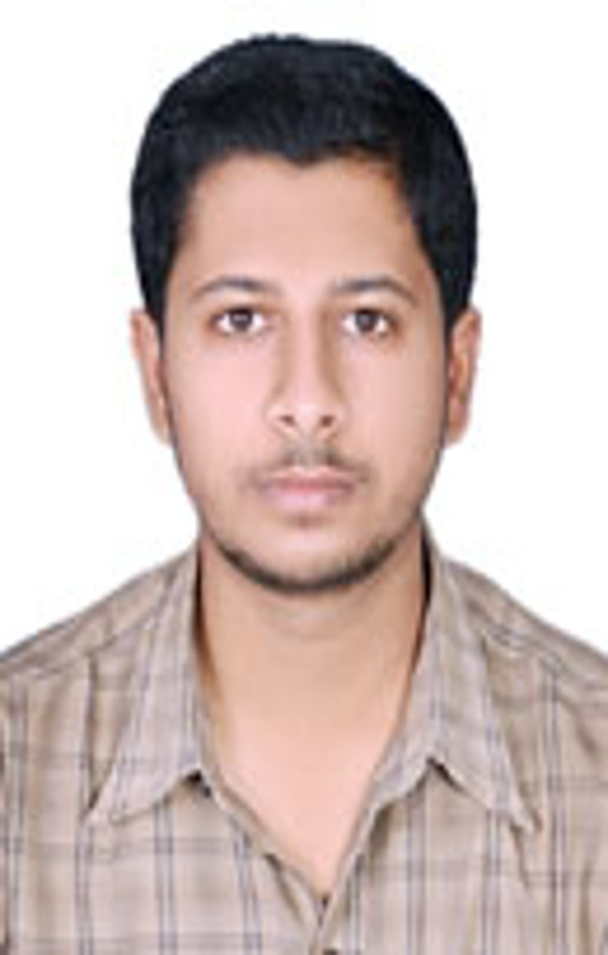
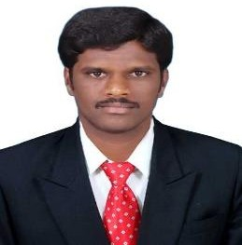

Kalpesh L Solanki
QA Engineer
Kalpesh is Quality analyst with 3+ years of experience driving excellence in creating, editing and implementing test instructions to improve quality and efficiency. Having knowledge in Automation Test developing,, Functional Testing and API testing, Java, Rest Assured, CI/CD ,Git. Excellent knowledge and implementation skills in complete Software Development Life Cycle ( SDLC ) and Software Testing Life Cycle ( STLC ). Good experience in writing, review and executing detailed test cases and test design documents for back and front-end testing. Have strong work ethic and commitment to excellence in all Projects.
Pune, India
Mobile: 7517858419
Relevant Tools/Skills
Relevant Experience
Database : SQL
Tools/Application :, Eclipse, Selenium, Cucumber, ALM, JIRA,, Postman, Rest Assured, Maven, My SQL Server, Jenkins, Git.
Programming languages: Core Java , SQL.
Extensive experience in automation script coding in Selenium Web-Driver using Java.
Experience in BDD-Cucumber Framework.
Expertise in handling TestNG and Junit framework. Having good knowledge in API Testing with Postman. Experience in Data Driven Testing.
Skilled in developing reusable functional components in the framework and developing POM with Page Factory Concept.
Good experience in REST ASSURED.
Very much familiar with Bug-Tracking tool - JIRA.
Strong Experience in OOPS Concepts and Java Programming.
Experience in test planning and designing testcases. Experienced in Maven build tool and version control using GIT.
Knowledge in writing basic SQL queries in backend testing for data integrity.
Having good knowledge in Agile Scrum Methodology.
Industry Sector Experience
Medledger, Health Data USA
Healthcare Domain
Executed assignments with the use of web applications and programming languages. Write well-designed and efficient code by using the best software development practices to validate the test cases
Involved in testing during the system testing or UAT phases

